Slide 1

Attention Span Analysis of the Macaque
Suffered Through by Ellison Holloway
Notes:
I present to you, my mini-project, where I analyzed the attention span of a macaque.

Slide 2
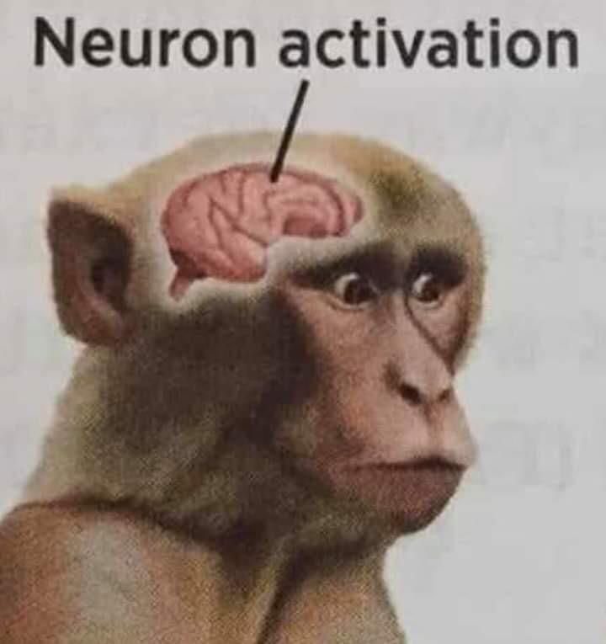
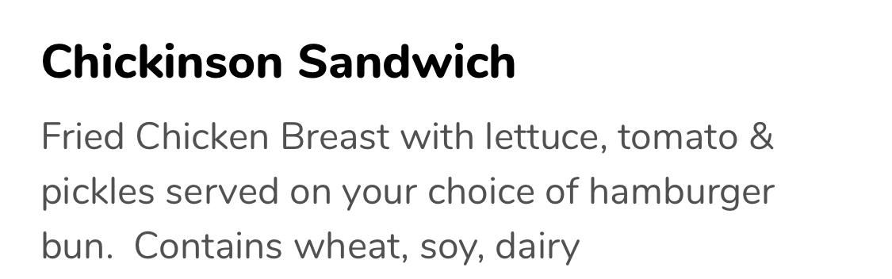
Research Question
What aspects of an environment affect attention?
Notes:
As for the research question, I have a simple one. What aspects of the immediate environment affect attention?

Slide 3
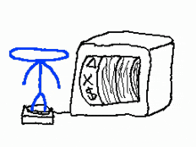
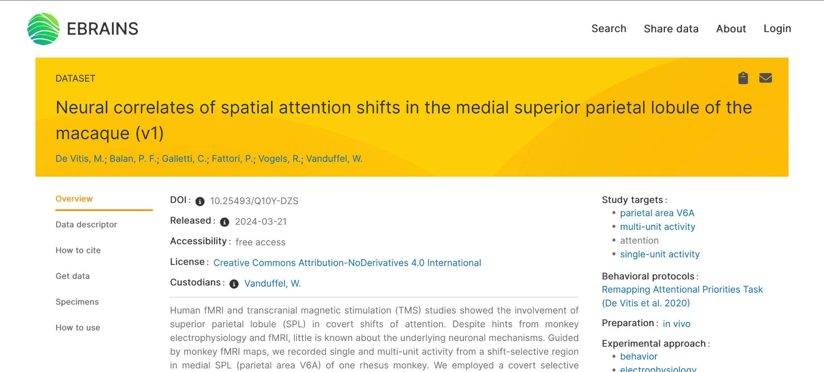
Data Acquisition
Notes:
I got the data from eBrains. There weren’t that many open-access studies that utilized neurological data, and the other studies that I tried either had broken acquisition sites, or the data was stored in file types that resisted my attempts to open them in python, so we’re going with this one.

Slide 4
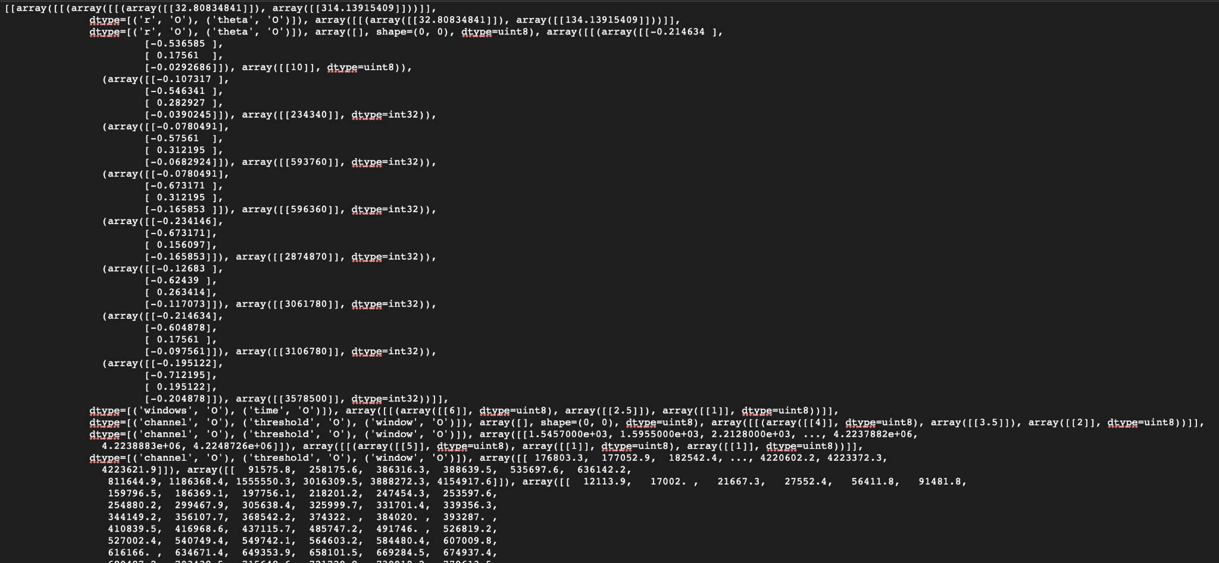
Data Acquisition
Notes:
And considering that the data looks like this when I paste it into my text editor of choice, I was in for a wild ride.

Slide 5
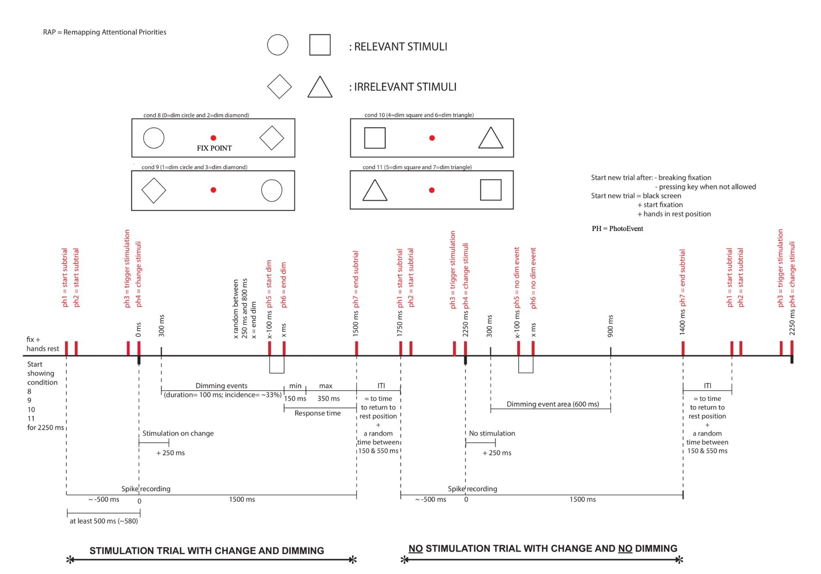
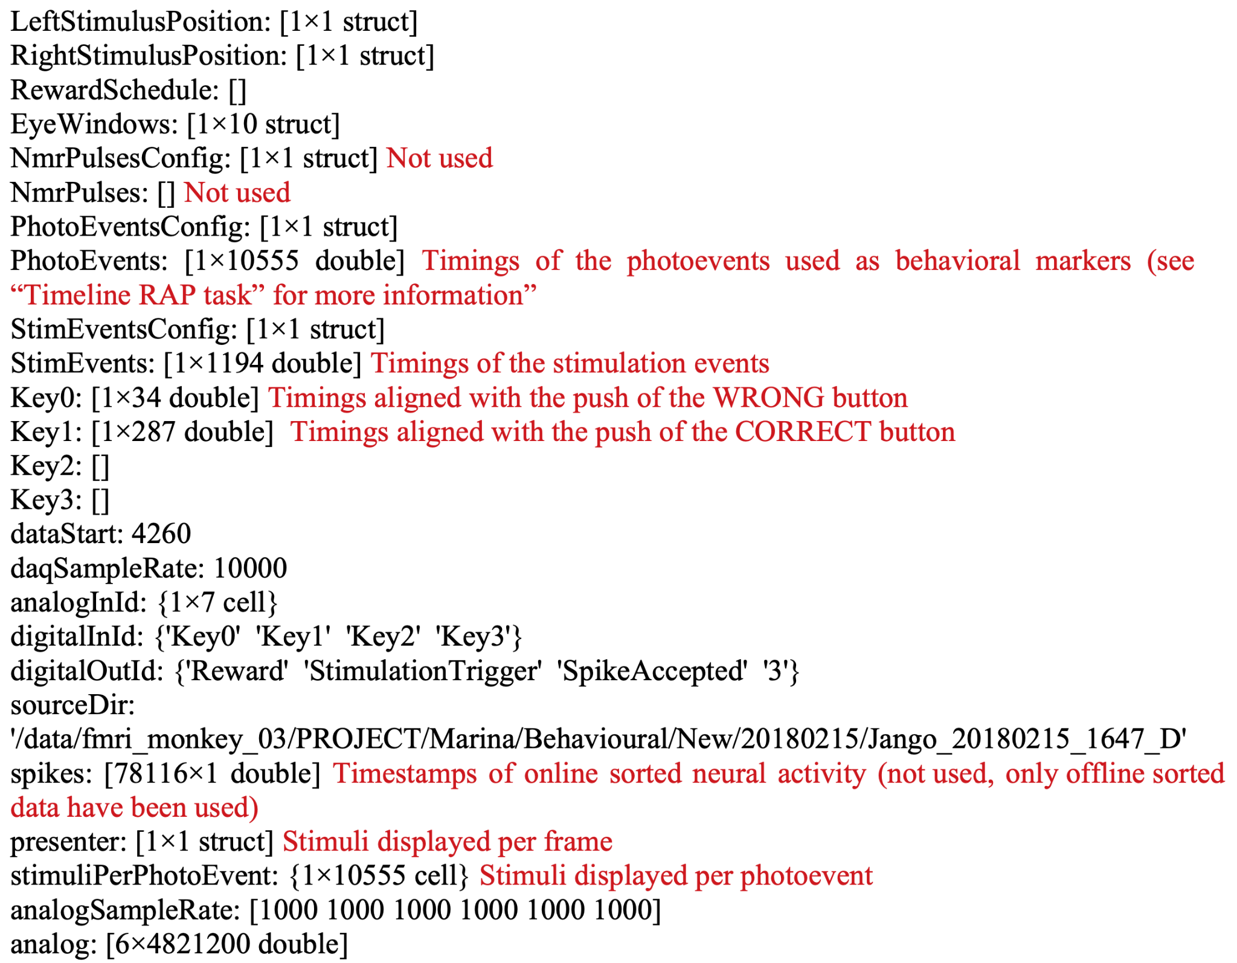
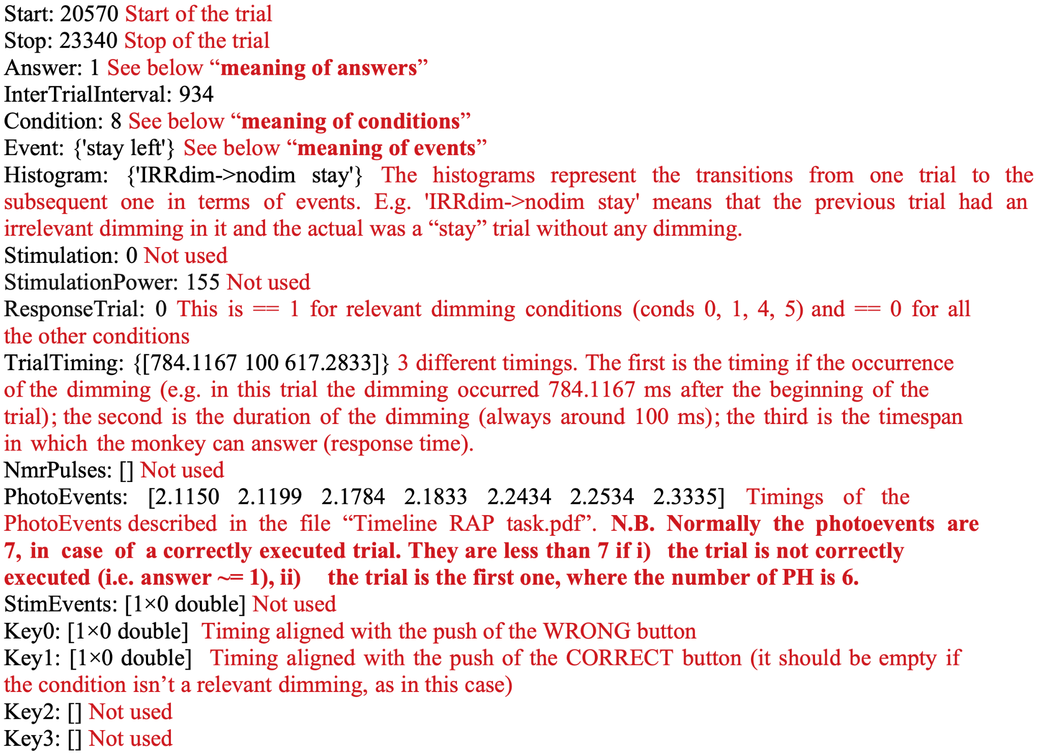
But what does it mean?
Notes:
But first, I should explain what the data is even talking about. The researchers placed a macaque monkey in an apparatus, whilst recording neurons in the brain area responsible for attention, for several trials. The monkey was trained to pay attention to the circle and square, and to disregard the diamond and the triangle. The screen would then switch which shape was where, the monkey would have to press the button that corresponded with the correct shape, and the apparatus would track the monkey’s attention. You might notice all of these lovely variables over here, and fear not, most of them were useless.

Slide 6

Data Cleanup
Half of the columns were useless. They were literally labeled as unused by the researchers recording the data, and yet they were kept in.
Half of the columns that are actually usable are entirely unlabeled. Your guess is as good as mine as to what the column “digital”, the 48212000 x 1 sub-table is supposed to mean.
Some of the data in here was stored as IMAGES. Needless to say, I did not use it. But I certainly tried.
Every single number was nested inside 2-3 unnecessary arrays that contained no other information other than said number.
Notes:
And so, the pain began. But since this project is not meant to focus on the cleanup portion, I will instead neatly summarize how much I despise this dataset, and you can read it at your leisure.

Slide 7
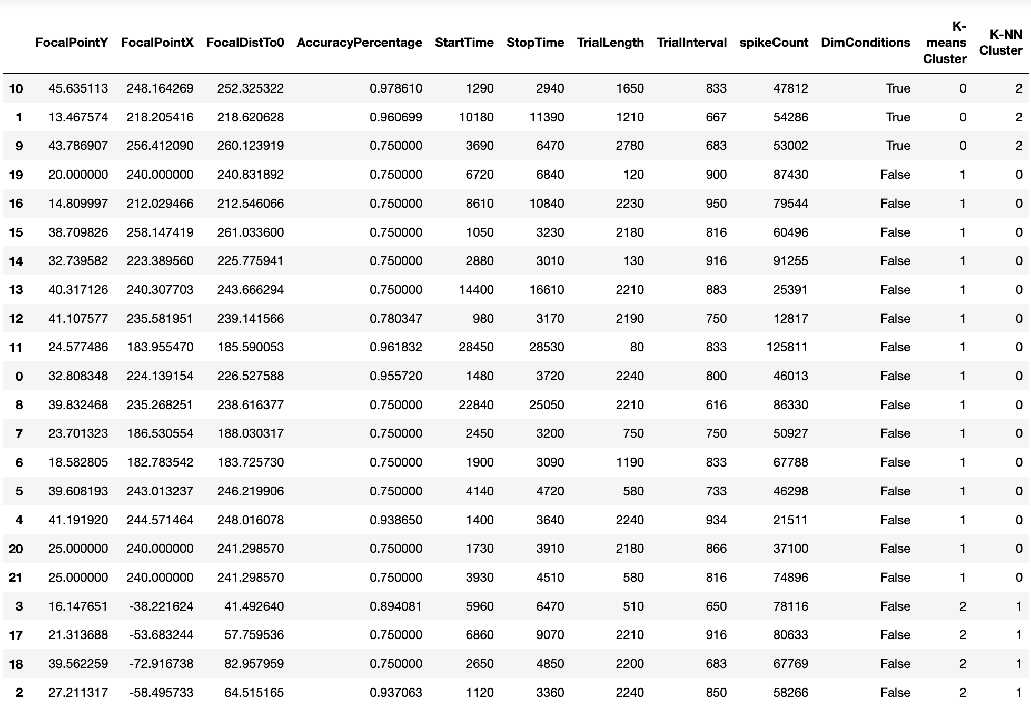
Data Analysis!
Notes:
Now for the fun part. I genuinely tried to inspect the files that contained the actual neuron scans, and tried to see if I could work with them, but the walls of floats felt entirely unsurpassable. Maybe I could have figured it out given a month, but I decided to save my sanity and work with some of the more approachable variables.
As for the variables that I’ve cleaned the data into, there’s the three that correspond to the focal point that the monkey was to stare at during the experiment. Awkwardly shoved next to it is the Percentage of Accurate Button Presses, which is the value that I am using as a proxy for attention, and as such am interested in studying in relation to all of the other variables. Additionally, there’s the starting and stopping times, as well as the of the experiments, to see if a loss of patience has anything to do with attention results. Next up is the spike count, which counts the number of times per experiment that the neurons fire, so there’s some pretty big numbers here. And last, but not least, is whether or not the screen dims as a part of the exercise.
As you can see by the Spike Count in particular, I needed to normalize this dataset before working on it. What you’re looking at is a non-normalized version of the dataset, with the results of the analysis tacked onto the end.
And speaking of which, according to the K-means and K-nearest-neighbor clustering that I’ve run on the dataset, the most important factors to determine their Accuracy Percentage seem to be whether or not the screen dimmed, and the position of the focal point.

Slide 8
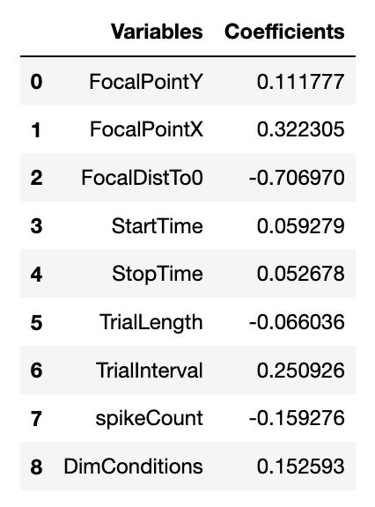
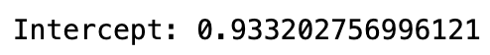
Data Analysis!
Notes:
As for what Linear Regression has to say on the matter, it seems to more or less agree. The coefficients on the focal point’s variables seems to suggest that the monkey had an easier time paying attention when stimuli was further to the side, as opposed to directly in front. Additionally, the time in between trials seems to affect accuracy, and as such, affects attention.
However, [CLICK] the unfortunate truth is, the y-intercept was quite high, suggesting that the other data points weren’t that conclusive and should be taken with a grain of salt.

Slide 9

Implications
For stakeholders: Monkeys and humans are quite similar, so one could use this analysis to optimize retention rates.
Ethically/legally/socially: The optimization of retention rates is responsible for a lot of harmful functions of various social media. This is a tactic that should be used with caution. But I know it won’t.
Notes:
As for the implications of this analysis, if it had worked, it could be of great use to any potential stakeholders, as given the similarities between monkeys and humans, one could optimize retention rates for anything from websites and apps, to books and movies. However, it’s probably a good thing this analysis was quite inconclusive, as this race to optimize for retention rates is responsible for a lot of harmful functions of social media. I bet phenomena such as ragebait and doomscrolling wouldn’t be a thing if retention wasn’t used as a proxy for user enjoyment.

Slide 10

Potential Next Steps
More data! 22 trials of a single monkey isn’t that many.
Figuring out how to read the MRI files
Notes:
Thank you for your time.

